Slide 1

Pizza Sales Analysis

Slide 2
About The Project
This project focuses on analyzing pizza sales data to gain useful insights into customer preferences and business performance. By examining the sales records, it identifies which pizzas are the most popular, which ones generate the highest revenue, and other important trends. The goal is to support better decision-making related to inventory, marketing, and menu planning. This analysis helps in understanding what drives sales and how to improve overall performance.

Slide 3
Questions answered through this project:-
1.Retrieve the total number of orders placed.
2. Calculate the total revenue generated from pizza sales.
3. Identify the highest-priced pizza.
4. Identify the most common pizza size ordered.
5. List the top 5 most ordered pizza types along with their quantities.
6. Join the necessary tables to find the total quantity of each pizza category ordered.
7. Determine the distribution of orders by hour of the day.
8. Join relevant tables to find the category-wise distribution of pizzas.
9. Group the orders by date and calculate the average number of pizzas ordered per day.
10. Determine the top 3 most ordered pizza types based on revenue.
11. Calculate the percentage contribution of each pizza type to total revenue.
12. Analyze the cumulative revenue generated over time.
13. Determine the top 3 most ordered pizza types based on revenue for each pizza category.

Slide 4
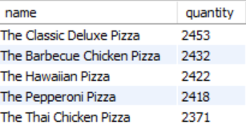
Questions answers as per the dataset:
The total number of pizza orders placed are :- 21350
Total revenue generated from pizza sales are:- 817860.05
The highest prize pizza is:-The Greek Pizza, 35.95
The most common pizza size ordered is:- L(large) having order count- 18526
Top 5 most ordered pizza types along with their quantities are:-

Slide 5
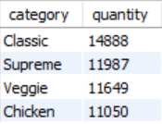
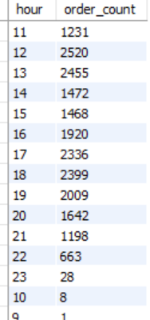
More queries answers:-
6. Total quantity of each pizza category ordered :-
7. The distribution of orders by hour of the day:-

Slide 6
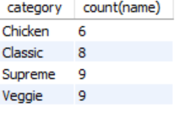
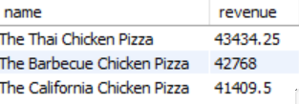
8. The category-wise distribution of pizzas:-
9. The average number of pizzas ordered per day as per the date is:- 138
10.The top 3 most ordered pizza types based on revenue are:-

Slide 7
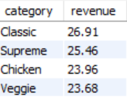
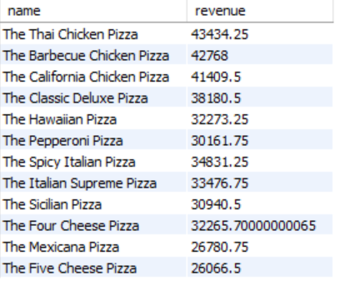
11. The percentage contribution of each pizza type to total revenue:-
12.The top 3 most ordered pizza types based on revenue for each pizza category:-

